Slide 1
Introduction to AI-Assisted Programming
Chris Cooling
ECRI Senior Teaching Fellow

Slide 2
Important Information on Marking your Attendance on Inkpath
I will show you a QR code at the end of the session allowing you to mark your attendance on Inkpath. Please do not mark your attendance until then. If you are a Postgraduate Research student, this is required for receiving your ECRI professional development credit for this course.

Slide 3
Learning Outcomes
Describe the basics of how generative AI works.
Discuss common ethical considerations around the use of generative AI in the context of programming.
Evaluate when it is appropriate to use AI assistance when programming.
Use a common generative AI tool to assist programming, including critically evaluating its output.
Design prompts most likely to produce useful outputs.

Slide 4
Course Materials
The course materials are stored in a GitHub repository
Instructions for using the materials are found in the readme
The materials are designed to be accessed through a GitHub Codespace
The materials can also be downloaded and run locally
You can also star/fork the repository

Slide 5
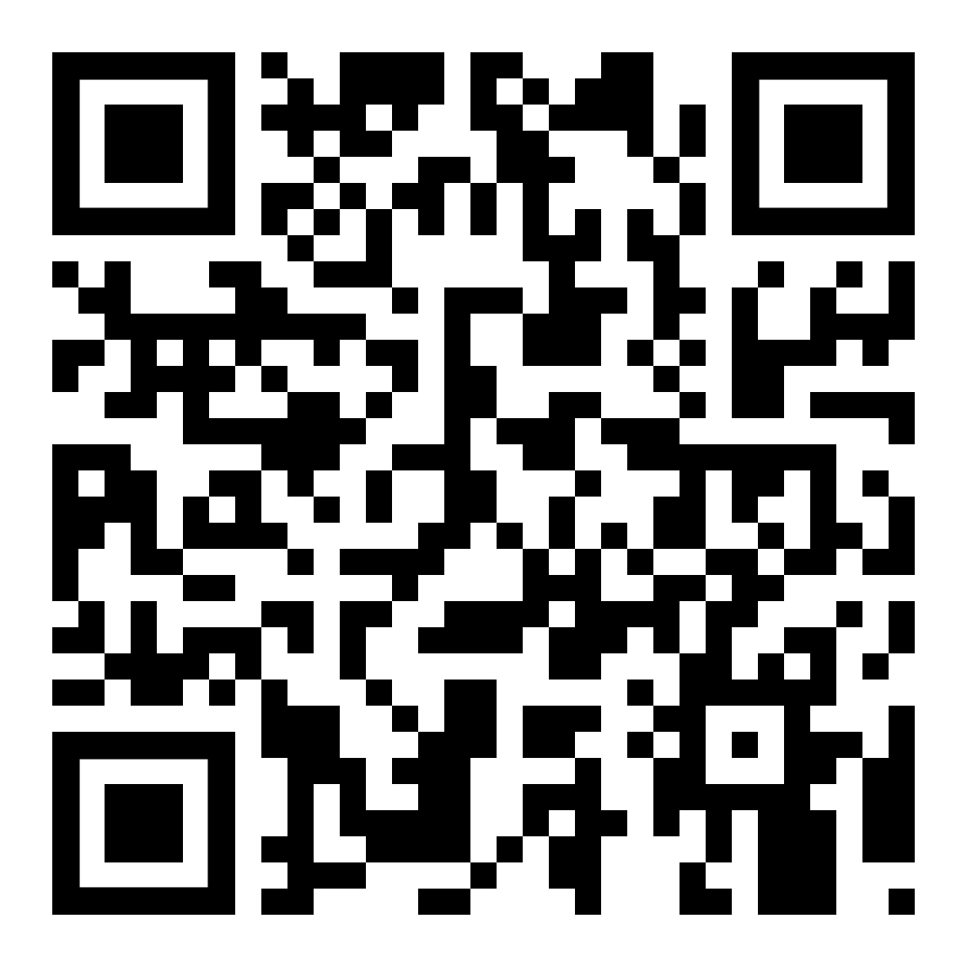
Please take 3 minutes to complete the evaluation
Once you’ve completed this course, please provide feedback
The link is https://ecri.short.gy/feedback-rcds
You should also have received an email with this link
This helps us improve the class for future students

Slide 6

PRES 2025
Coming in 2025 - PRES is a national survey for research degree students
Find out more about the action we have taken in response to the previous PRES:
Postgraduate Research Experience Survey (PRES) | Current students | Imperial College London
Presentation Title
DD/MM/YYYY
Notes:
Remove after PRES closes

Slide 7
Thank you
Presentation Title
DD/MM/YYYY

